Slide 1
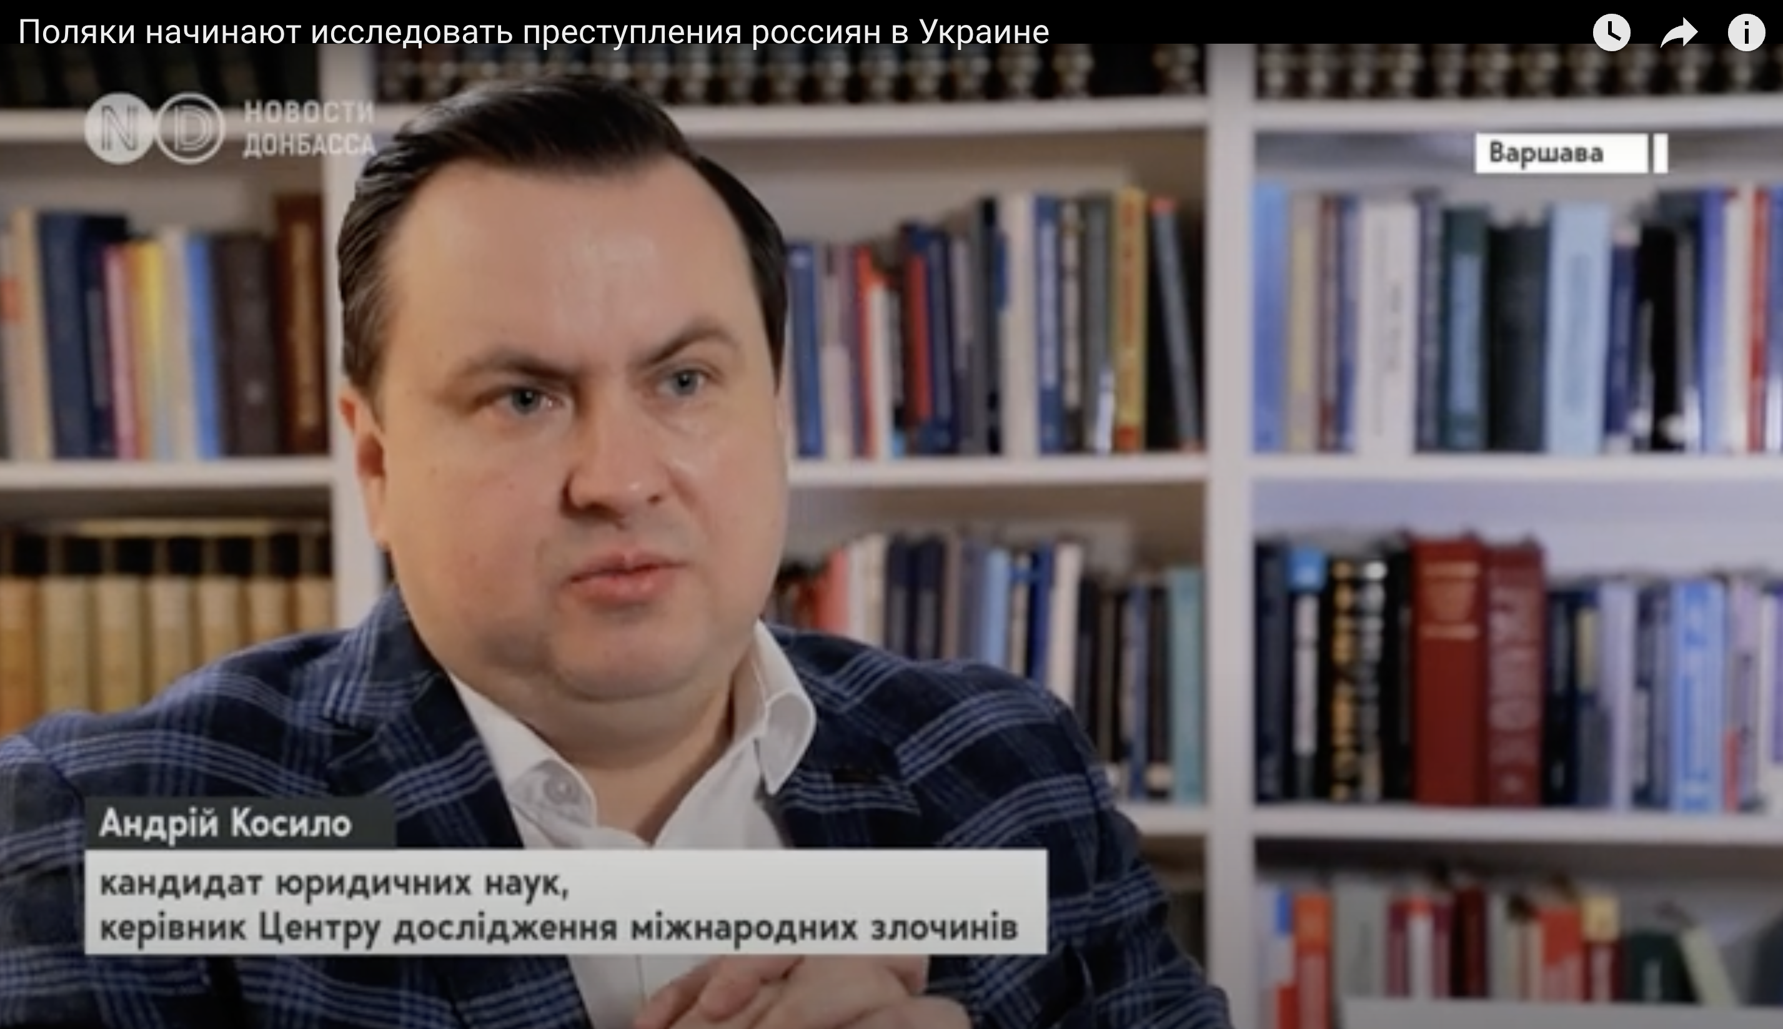
Video Recording of Dr. Kosylo’s Interview for Novyny Donbasu on the Activities of the International Crimes Studies Center at the University of Warsaw (17.12.2022).
Link to the video:
https://www.youtube.com/watch?v=oJ8SrskPrbk

Slide 2
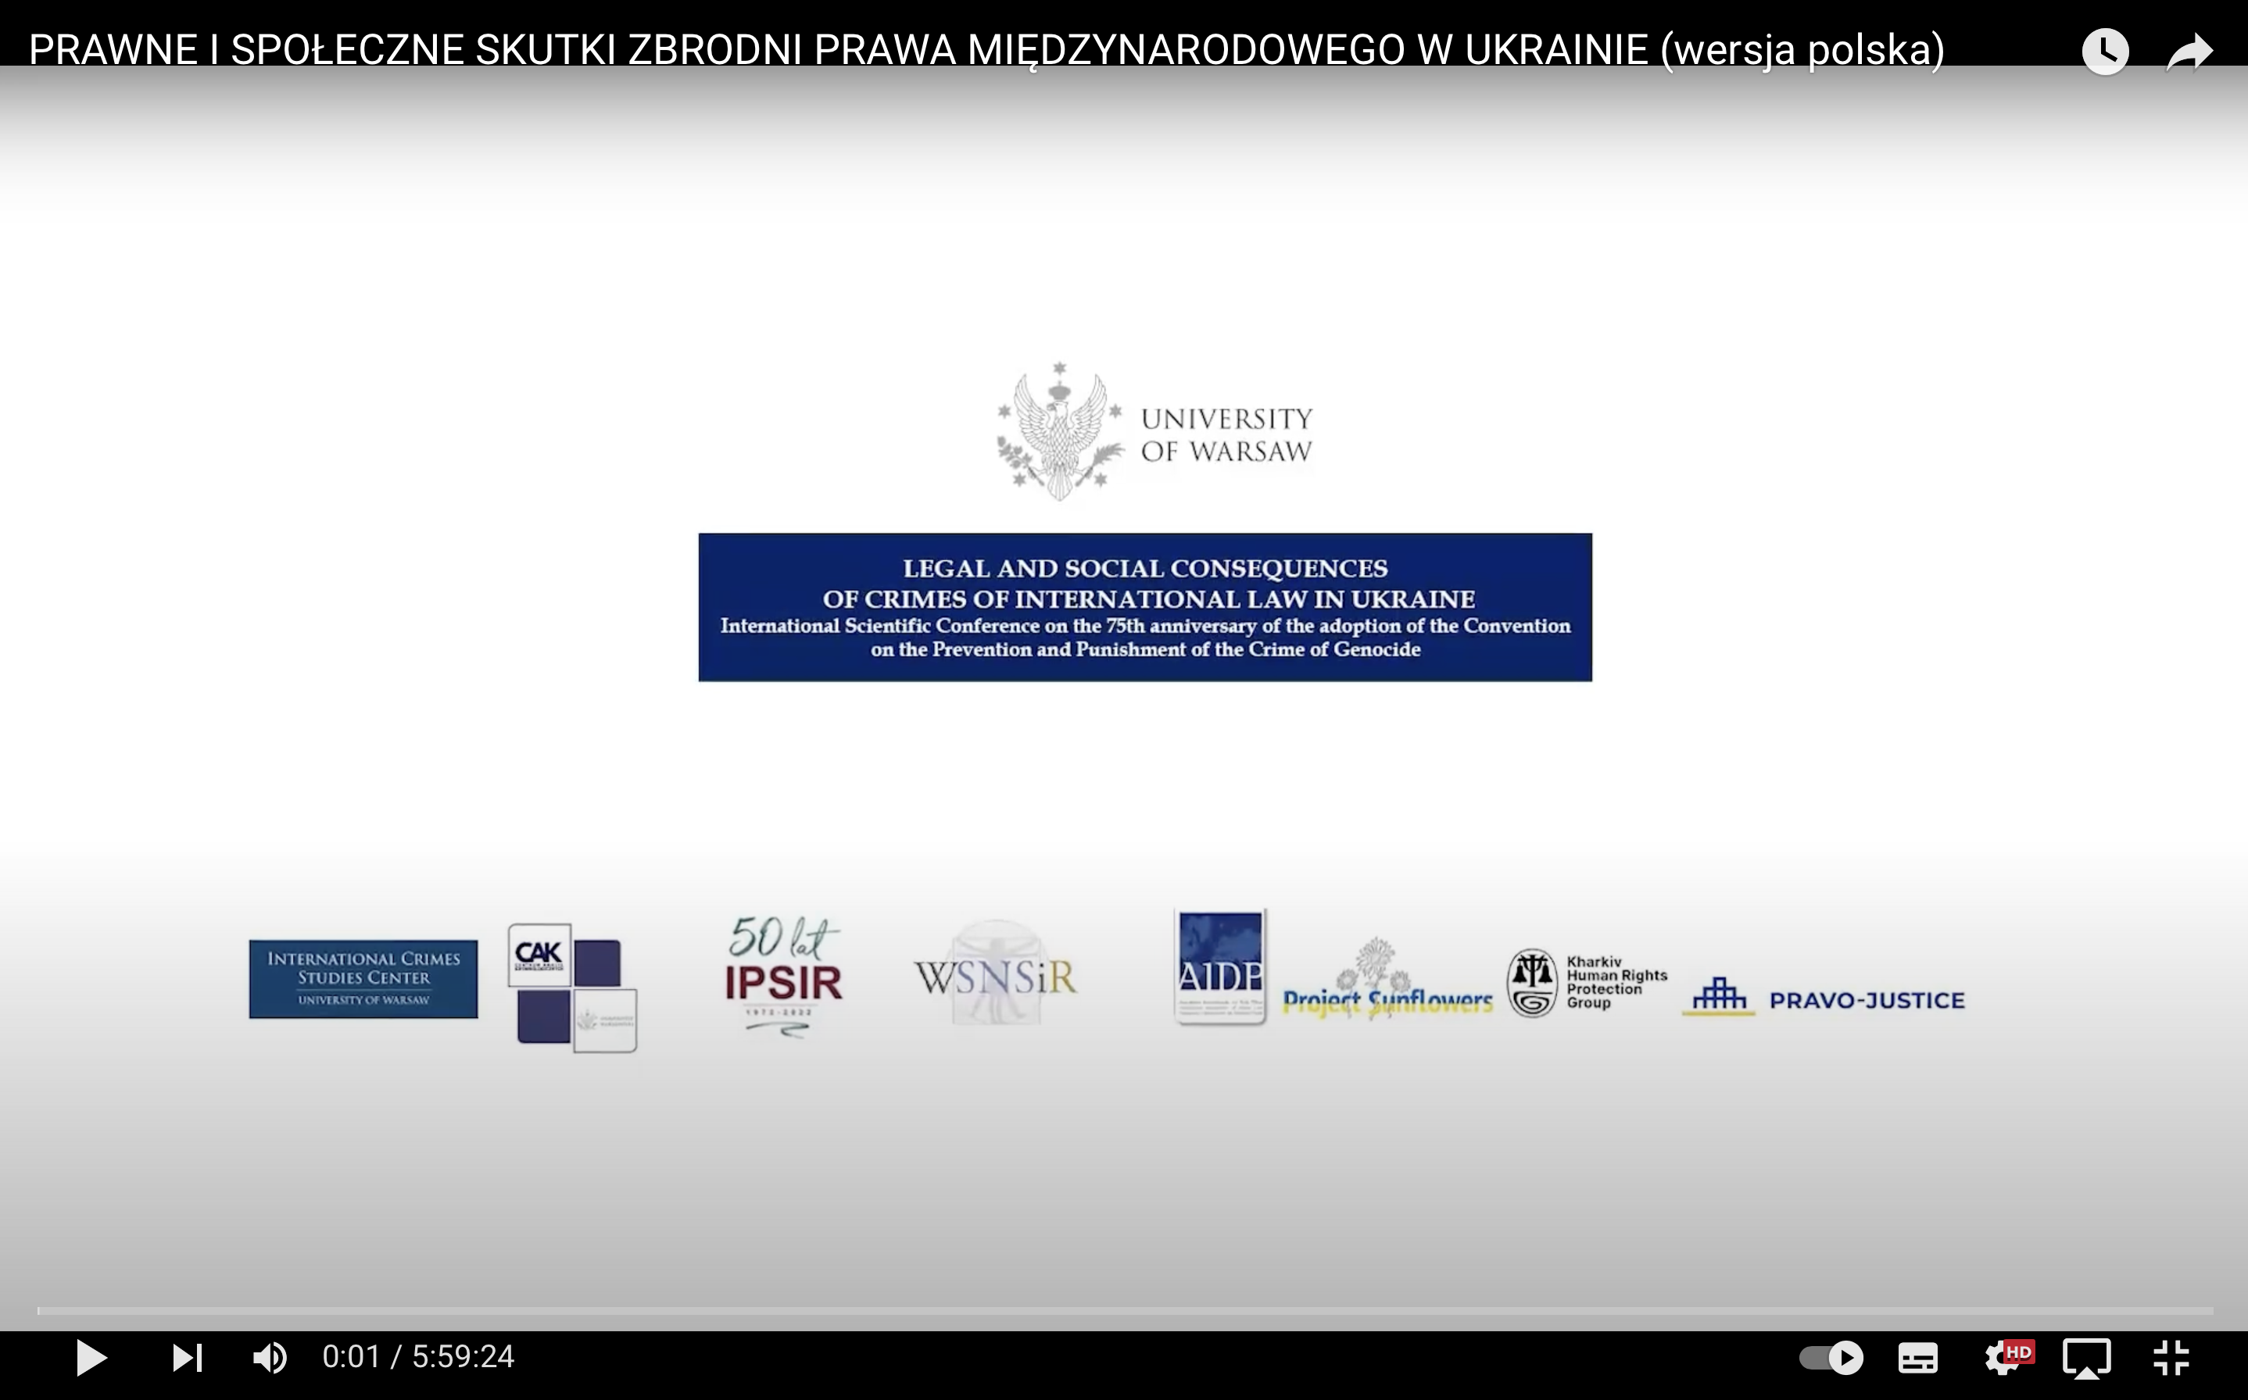
Video Recording of the International Scientific Conference on the 75th Anniversary of the Adoption of the Convention on the Prevention and Punishment of the Crime of Genocide: “Legal and Social Consequences of International Crimes in Ukraine” (14.12.2023)
Polish Version:
https://youtu.be/1bGi1XHbO7A?si=5Wi84goDxzosnST5

Slide 3
Video Recording of the International Scientific Conference on the 75th Anniversary of the Adoption of the Convention on the Prevention and Punishment of the Crime of Genocide: “Legal and Social Consequences of International Crimes in Ukraine” (14.12.2023)
English version:
https://www.youtube.com/watch?v=eZWZvGd-u2A

Slide 4
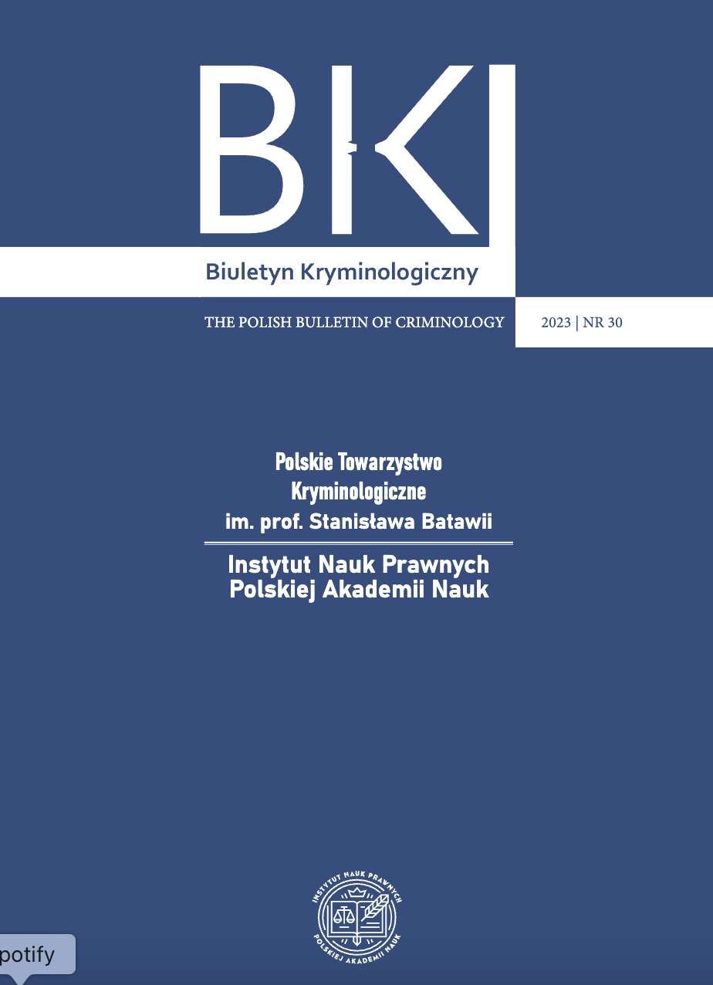
Publication:
Andriy Kosylo | Report on the International Scientific Conference on the 75th Anniversary of the Adoption of the Convention on the Prevention and Punishment of the Crime of Genocide: “Legal and Social Consequences of International Crimes in Ukraine,” Warsaw, December 14, 2023.
https://czasopisma.inp.pan.pl/index.php/bk/issue/view/373/303

