Slide 1
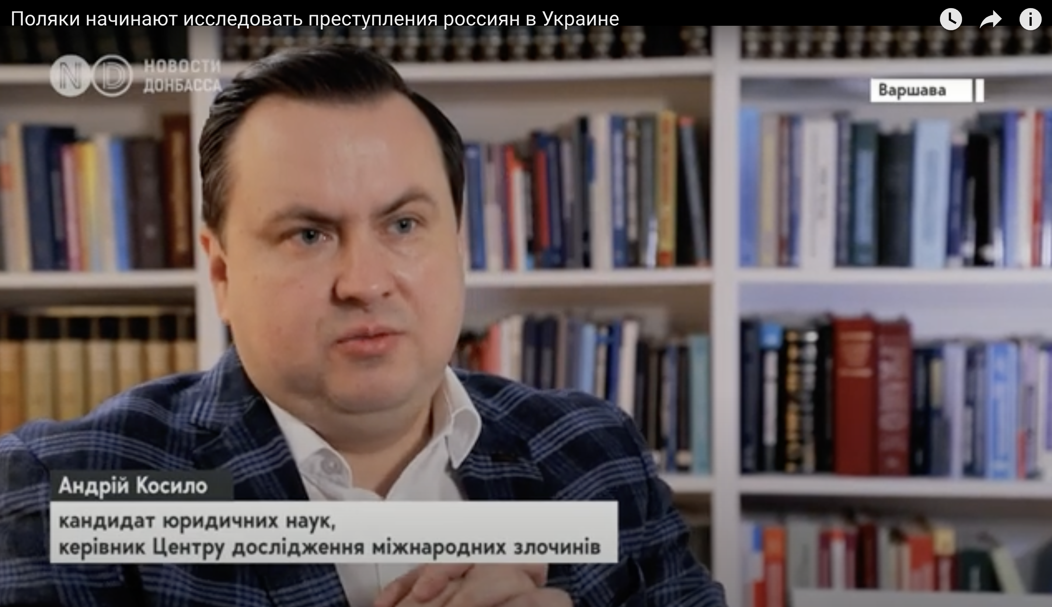
17.12.2022 r.
Interview with Dr. Kosylo for “Novyny Donbasu” on the Activities of the International Crimes Studies Center at the University of Warsaw.
In the interview, Dr. Kosylo discusses the mission and tasks of the Center, as well as the challenges related to prosecuting international crimes committed in Ukraine.
Link do wideo: https://www.youtube.com/watch?v=oJ8SrskPrbk

Slide 2
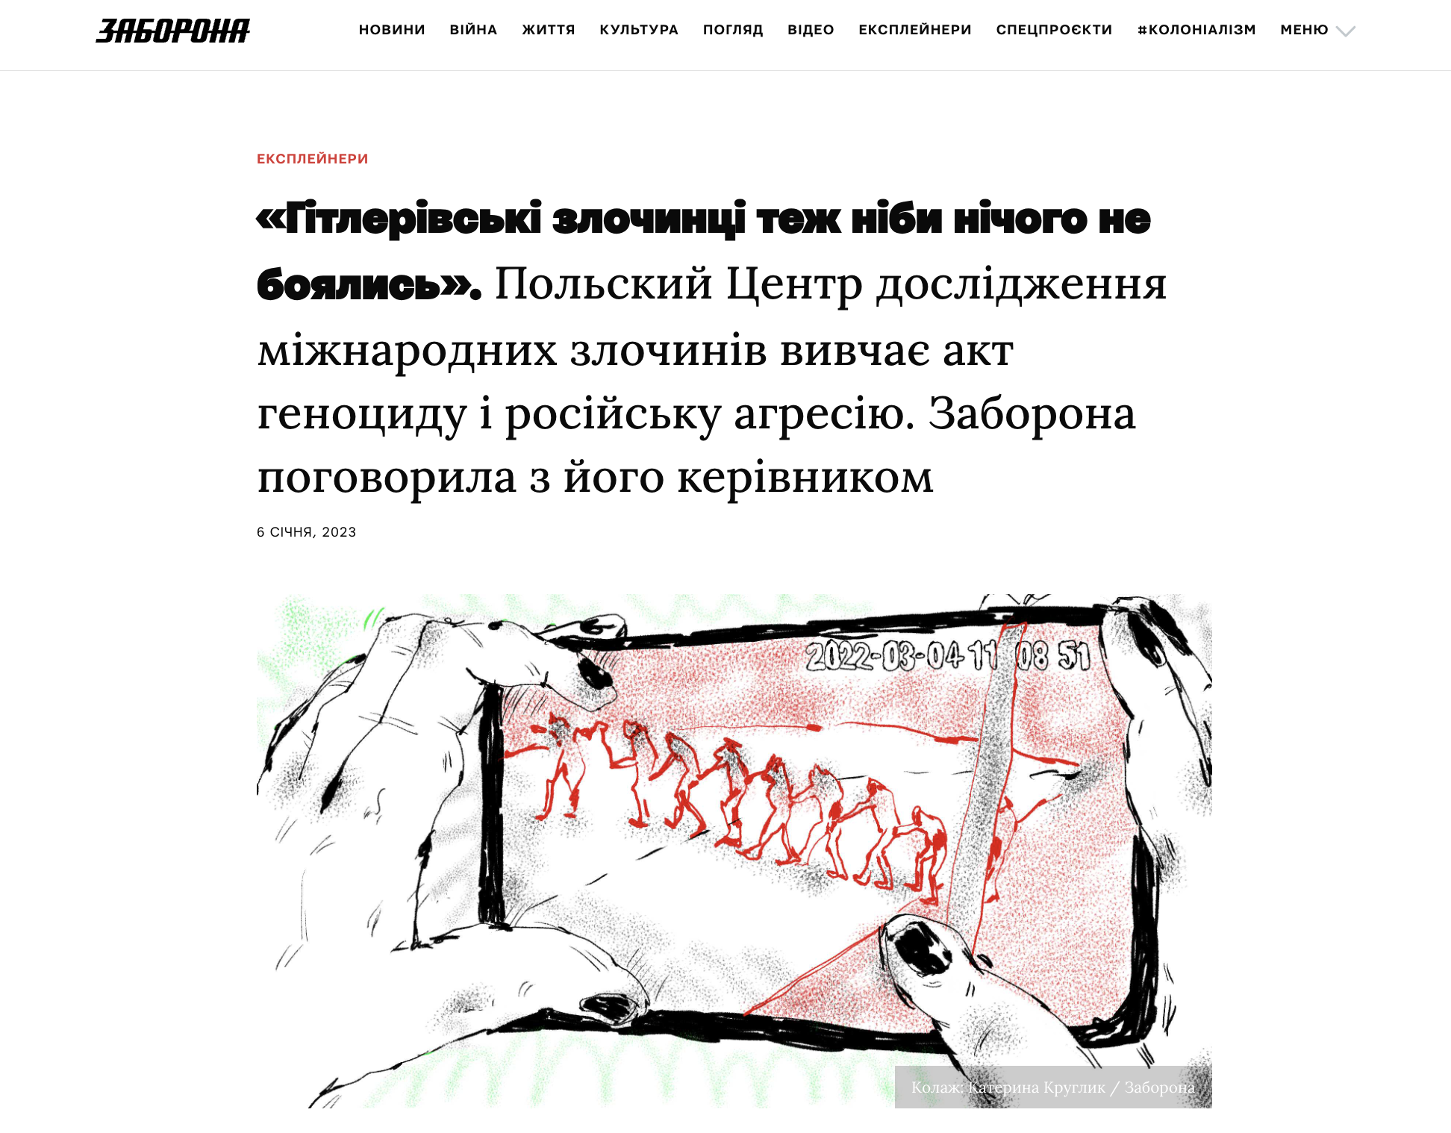
06.01.2023
Nazi Criminals Were Also Fearless: The Polish International Crimes Studies Center Investigates Acts of Genocide and the Crime of Aggression
An interview with Dr. Kosylo for the Ukrainian platform Zaborona.com, where he discusses the Center’s research on genocide and crimes of aggression.
https://zaborona.com/polskyj-czentr-doslidzhennya-mizhnarodnyh-zlochyniv-vyvchaye-akt-genoczydu-i-rosijsku-agresiyu/

Slide 3
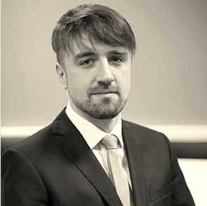
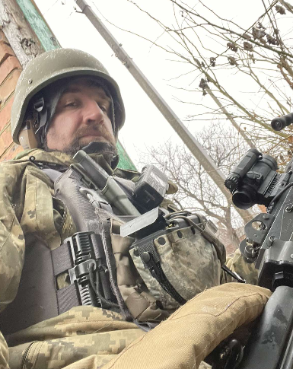
Literatura podstawowa:
6.02.2023
On February 6, 2023, a meeting was held at the International Crimes Studies Center of the University of Warsaw with Oleg Voloshynovych, a soldier of the Armed Forces of Ukraine.
Before the war, Oleg Voloshynovych was a practicing attorney in Kyiv and a doctoral candidate at the Academy of Legal Sciences of Ukraine.
Topic of the meeting: Russian war crimes in Ukraine.

Slide 4
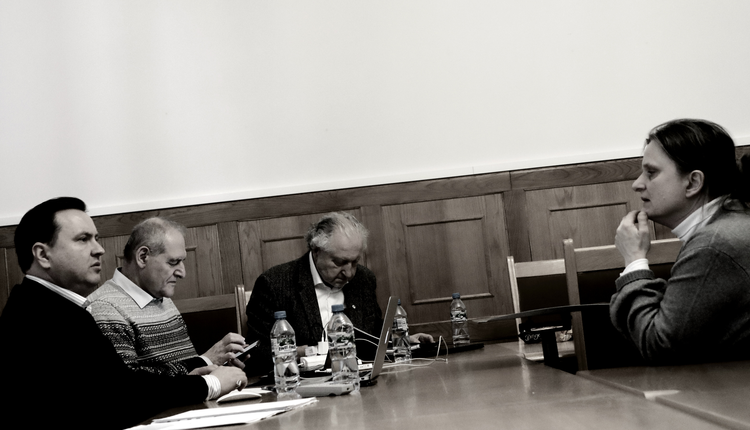
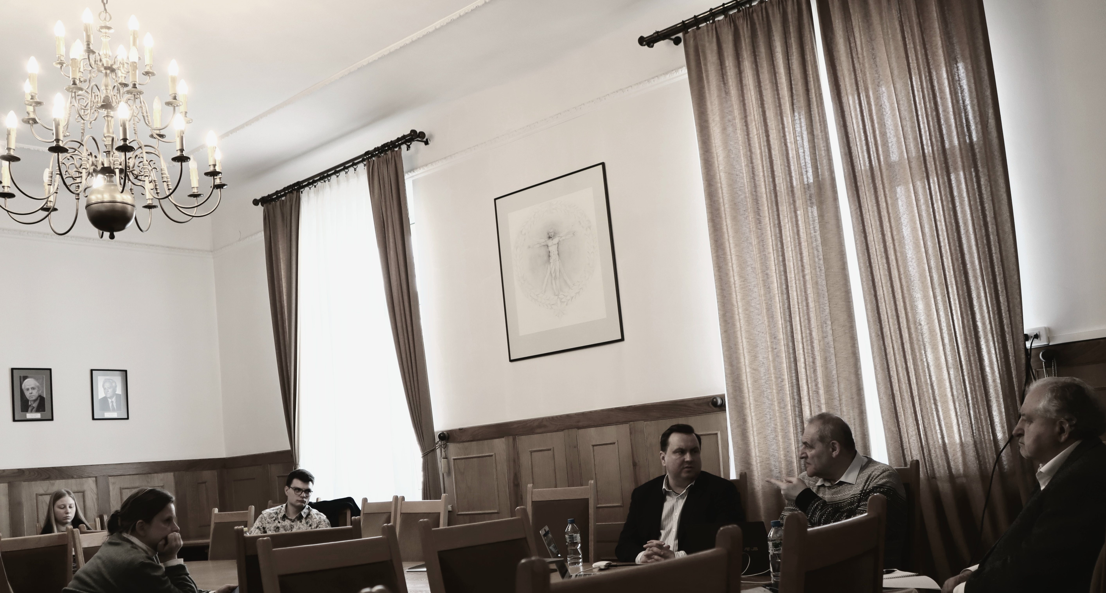
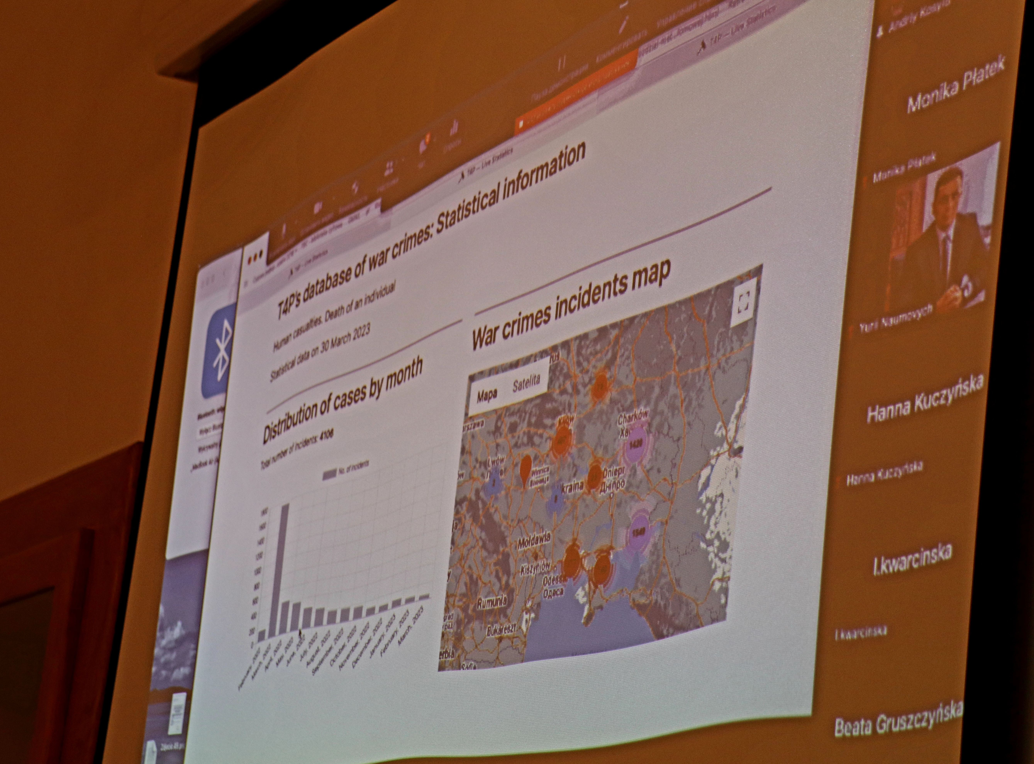
Literatura podstawowa:
30.03.2023
On March 30, 2023, the International Crimes Studies Center of the University of Warsaw hosted a Scientific Seminar featuring Mr. Yevhen Zakharov.
Title of the seminar: Russian International Law Crimes in Ukraine – Evidence Collection by the Kharkiv Human Rights Protection Group.
Participation in the event was also available online via the Zoom platform.

Slide 5
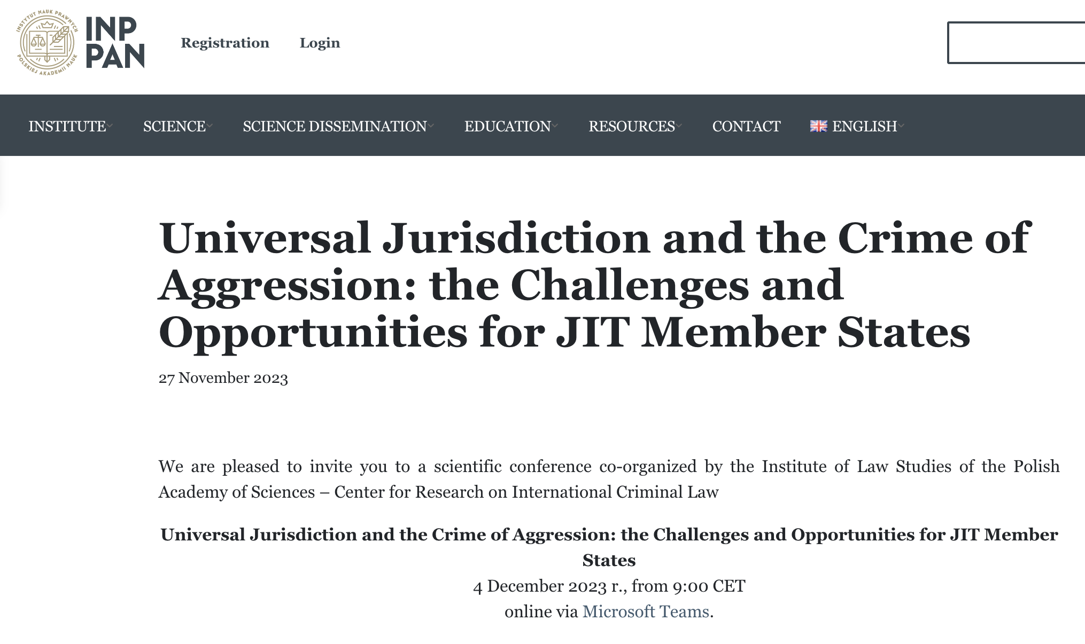
5.12.2023
On December 4, 2023, a conference titled Universal Jurisdiction and the Crime of Aggression: the Challenges and Opportunities for JIT Member States was held.
The conference was organized by the Institute of Legal Studies of the Polish Academy of Sciences, Vrije University Amsterdam and Tallinn University. Participants in the conference included, among others: Gabrielė Chlevickaitė (Asser Institute), Łukasz Kułaga (Cardinal Stefan Wyszyński University in Warsaw), Małgorzata Biszczanik (University of Warsaw), Tamás Hoffmann (Corvinus University of Budapest), Karolina Aksamitowska (Tallinn University), Dovilė Sagatienė (University of Copenhagen), Anton Korynevych (Ambassador-at-Large in the Ministry of Foreign Affairs of Ukraine), Oksana Senatorova (Research Centre for Transitional Justice), Mykhaylo Shepitko (Yaroslav Mudryi National Law University), Michał Nasiłowski (National Prosecutor’s Office in Poland), Ankit Malhotra (SOAS University of London), Gabija Grigaitė-Daugirdė (Vice-minister, Ministry of Justice of the Republic of Lithuania). The conference also featured representatives of the International Crimes Studies Center, Anastasiia Dmytriv and Andriy Kosylo, who delivered a speech titled: Implementation and Interpretation of the International Crimes’ Definitions in National Jurisdictions of Ukraine.

Slide 6
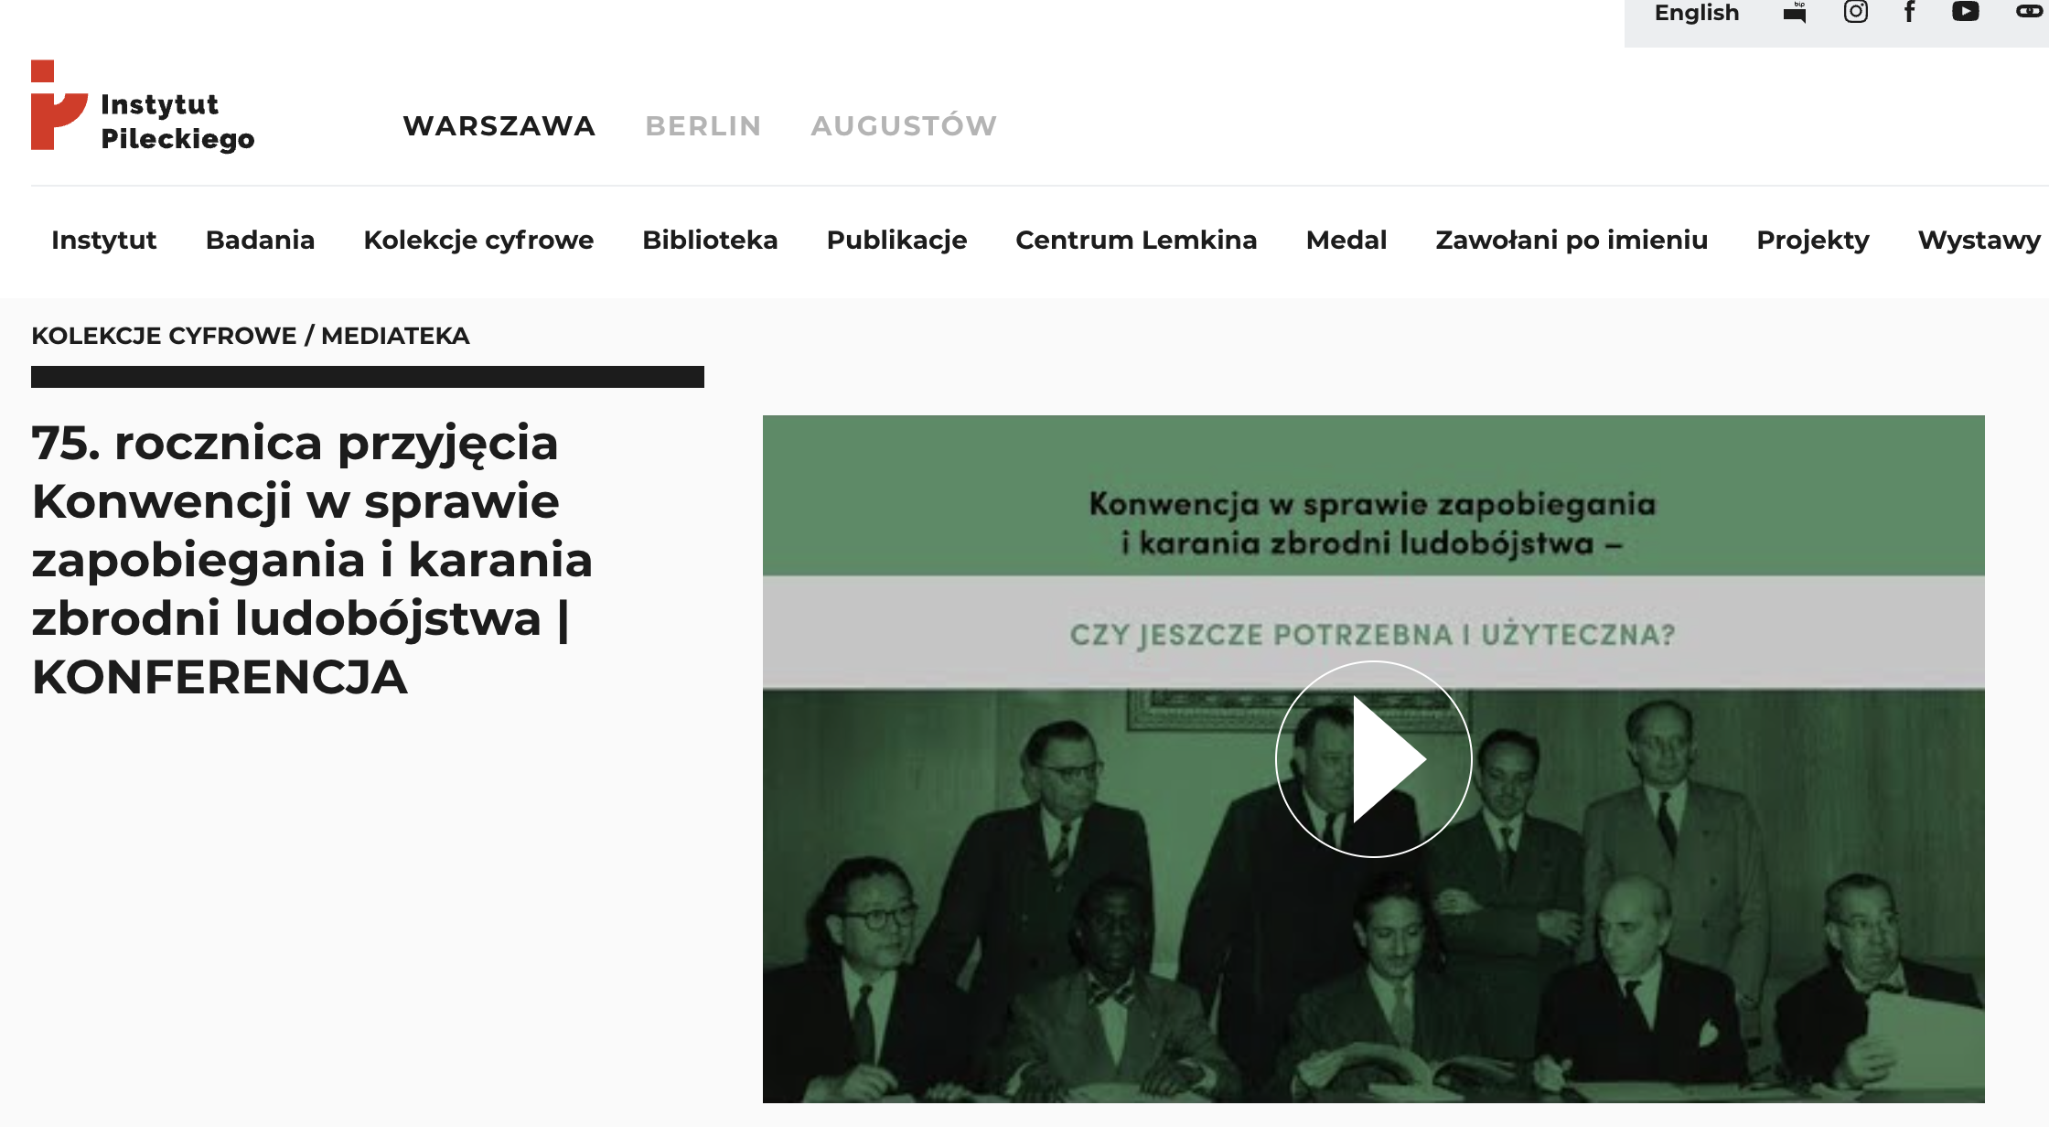
On December 11, 2023, a conference titled “The Convention on the Prevention and Punishment of the Crime of Genocide – Is It Still Needed and Useful?” was held in Warsaw.
The conference was organized by the Pilecki Institute. Representatives of the International Crimes Studies Center also participated in the event.
Link to the conference:
https://instytutpileckiego.pl/pl/kolekcje-cyfrowe/mediateka/75-rocznica-przyjecia-konwencji-w-sprawie-zapobiegania-i

Slide 7
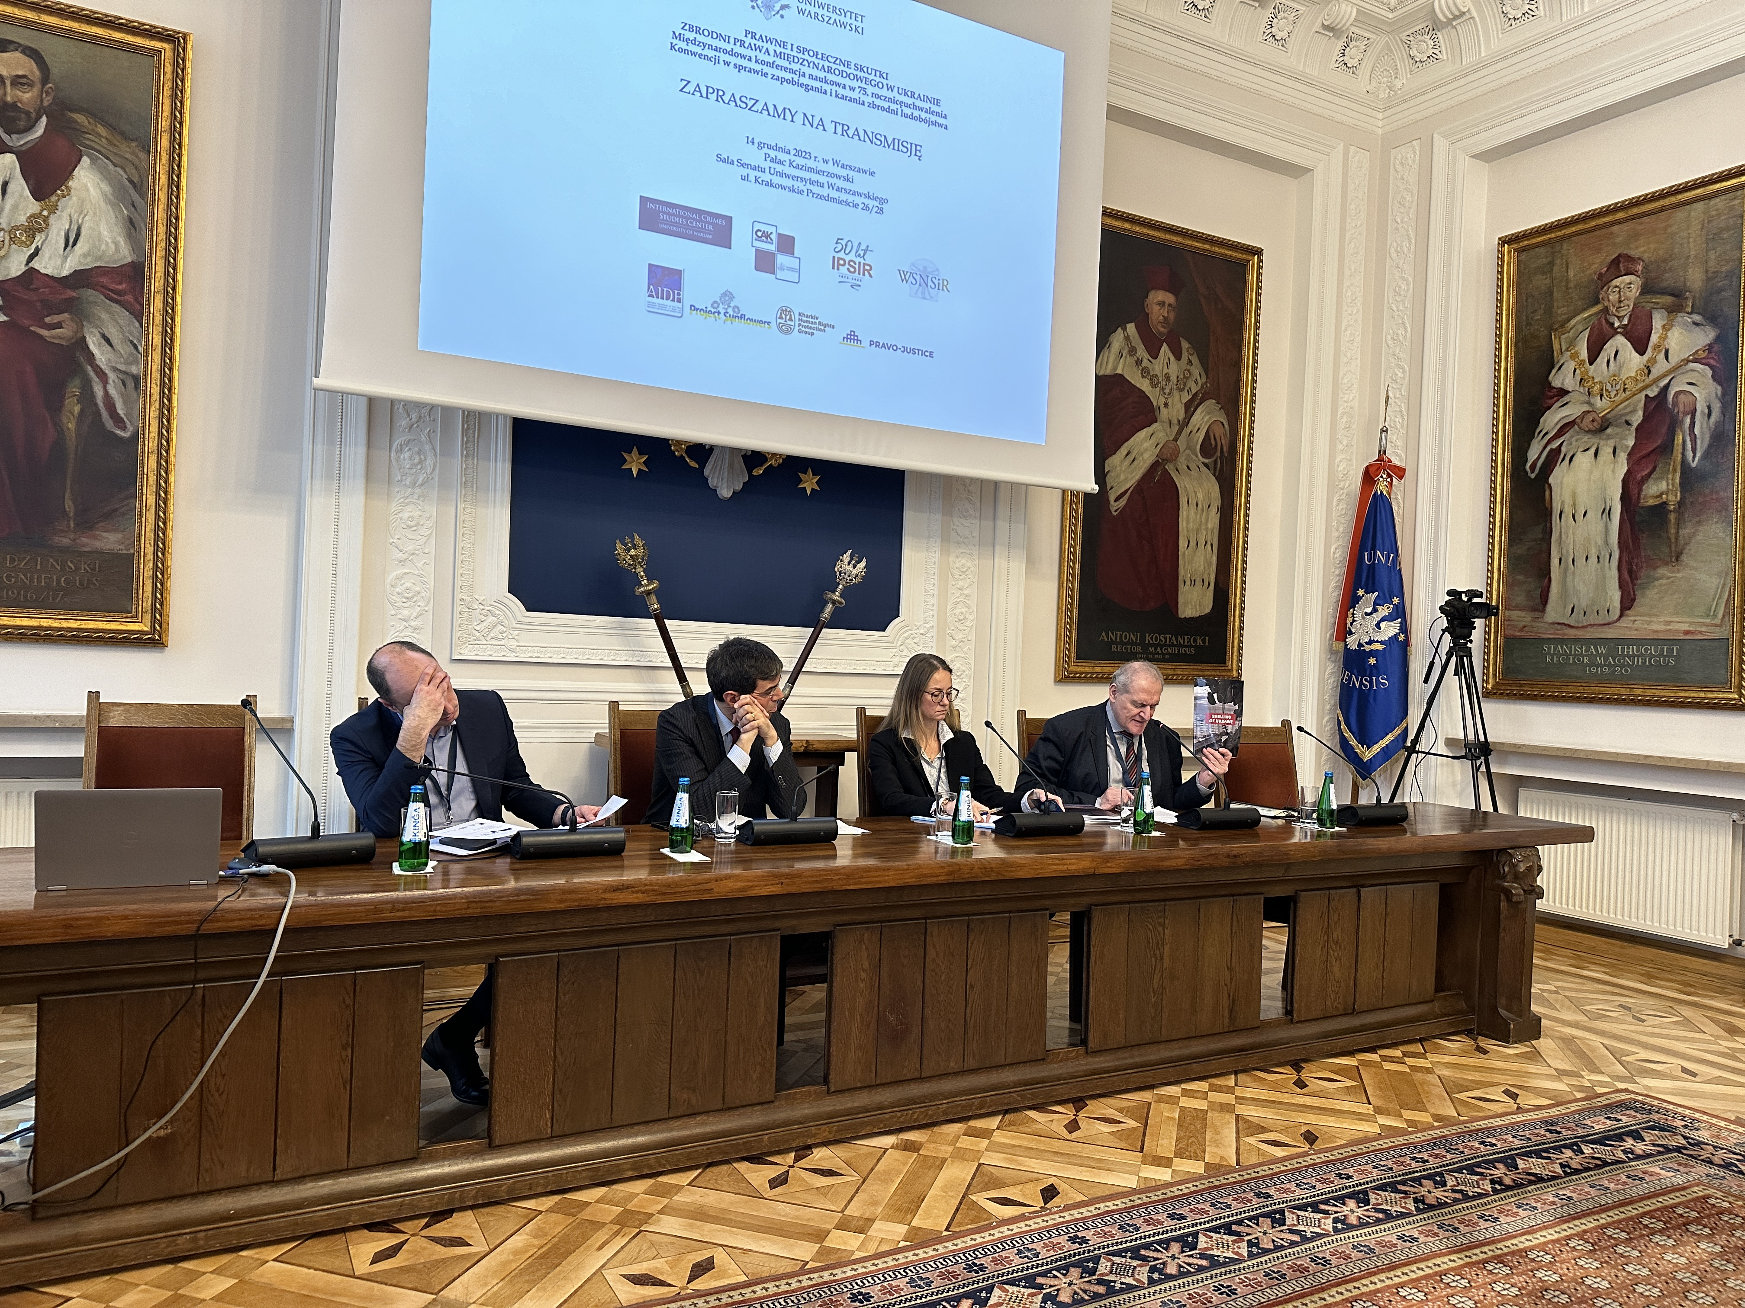
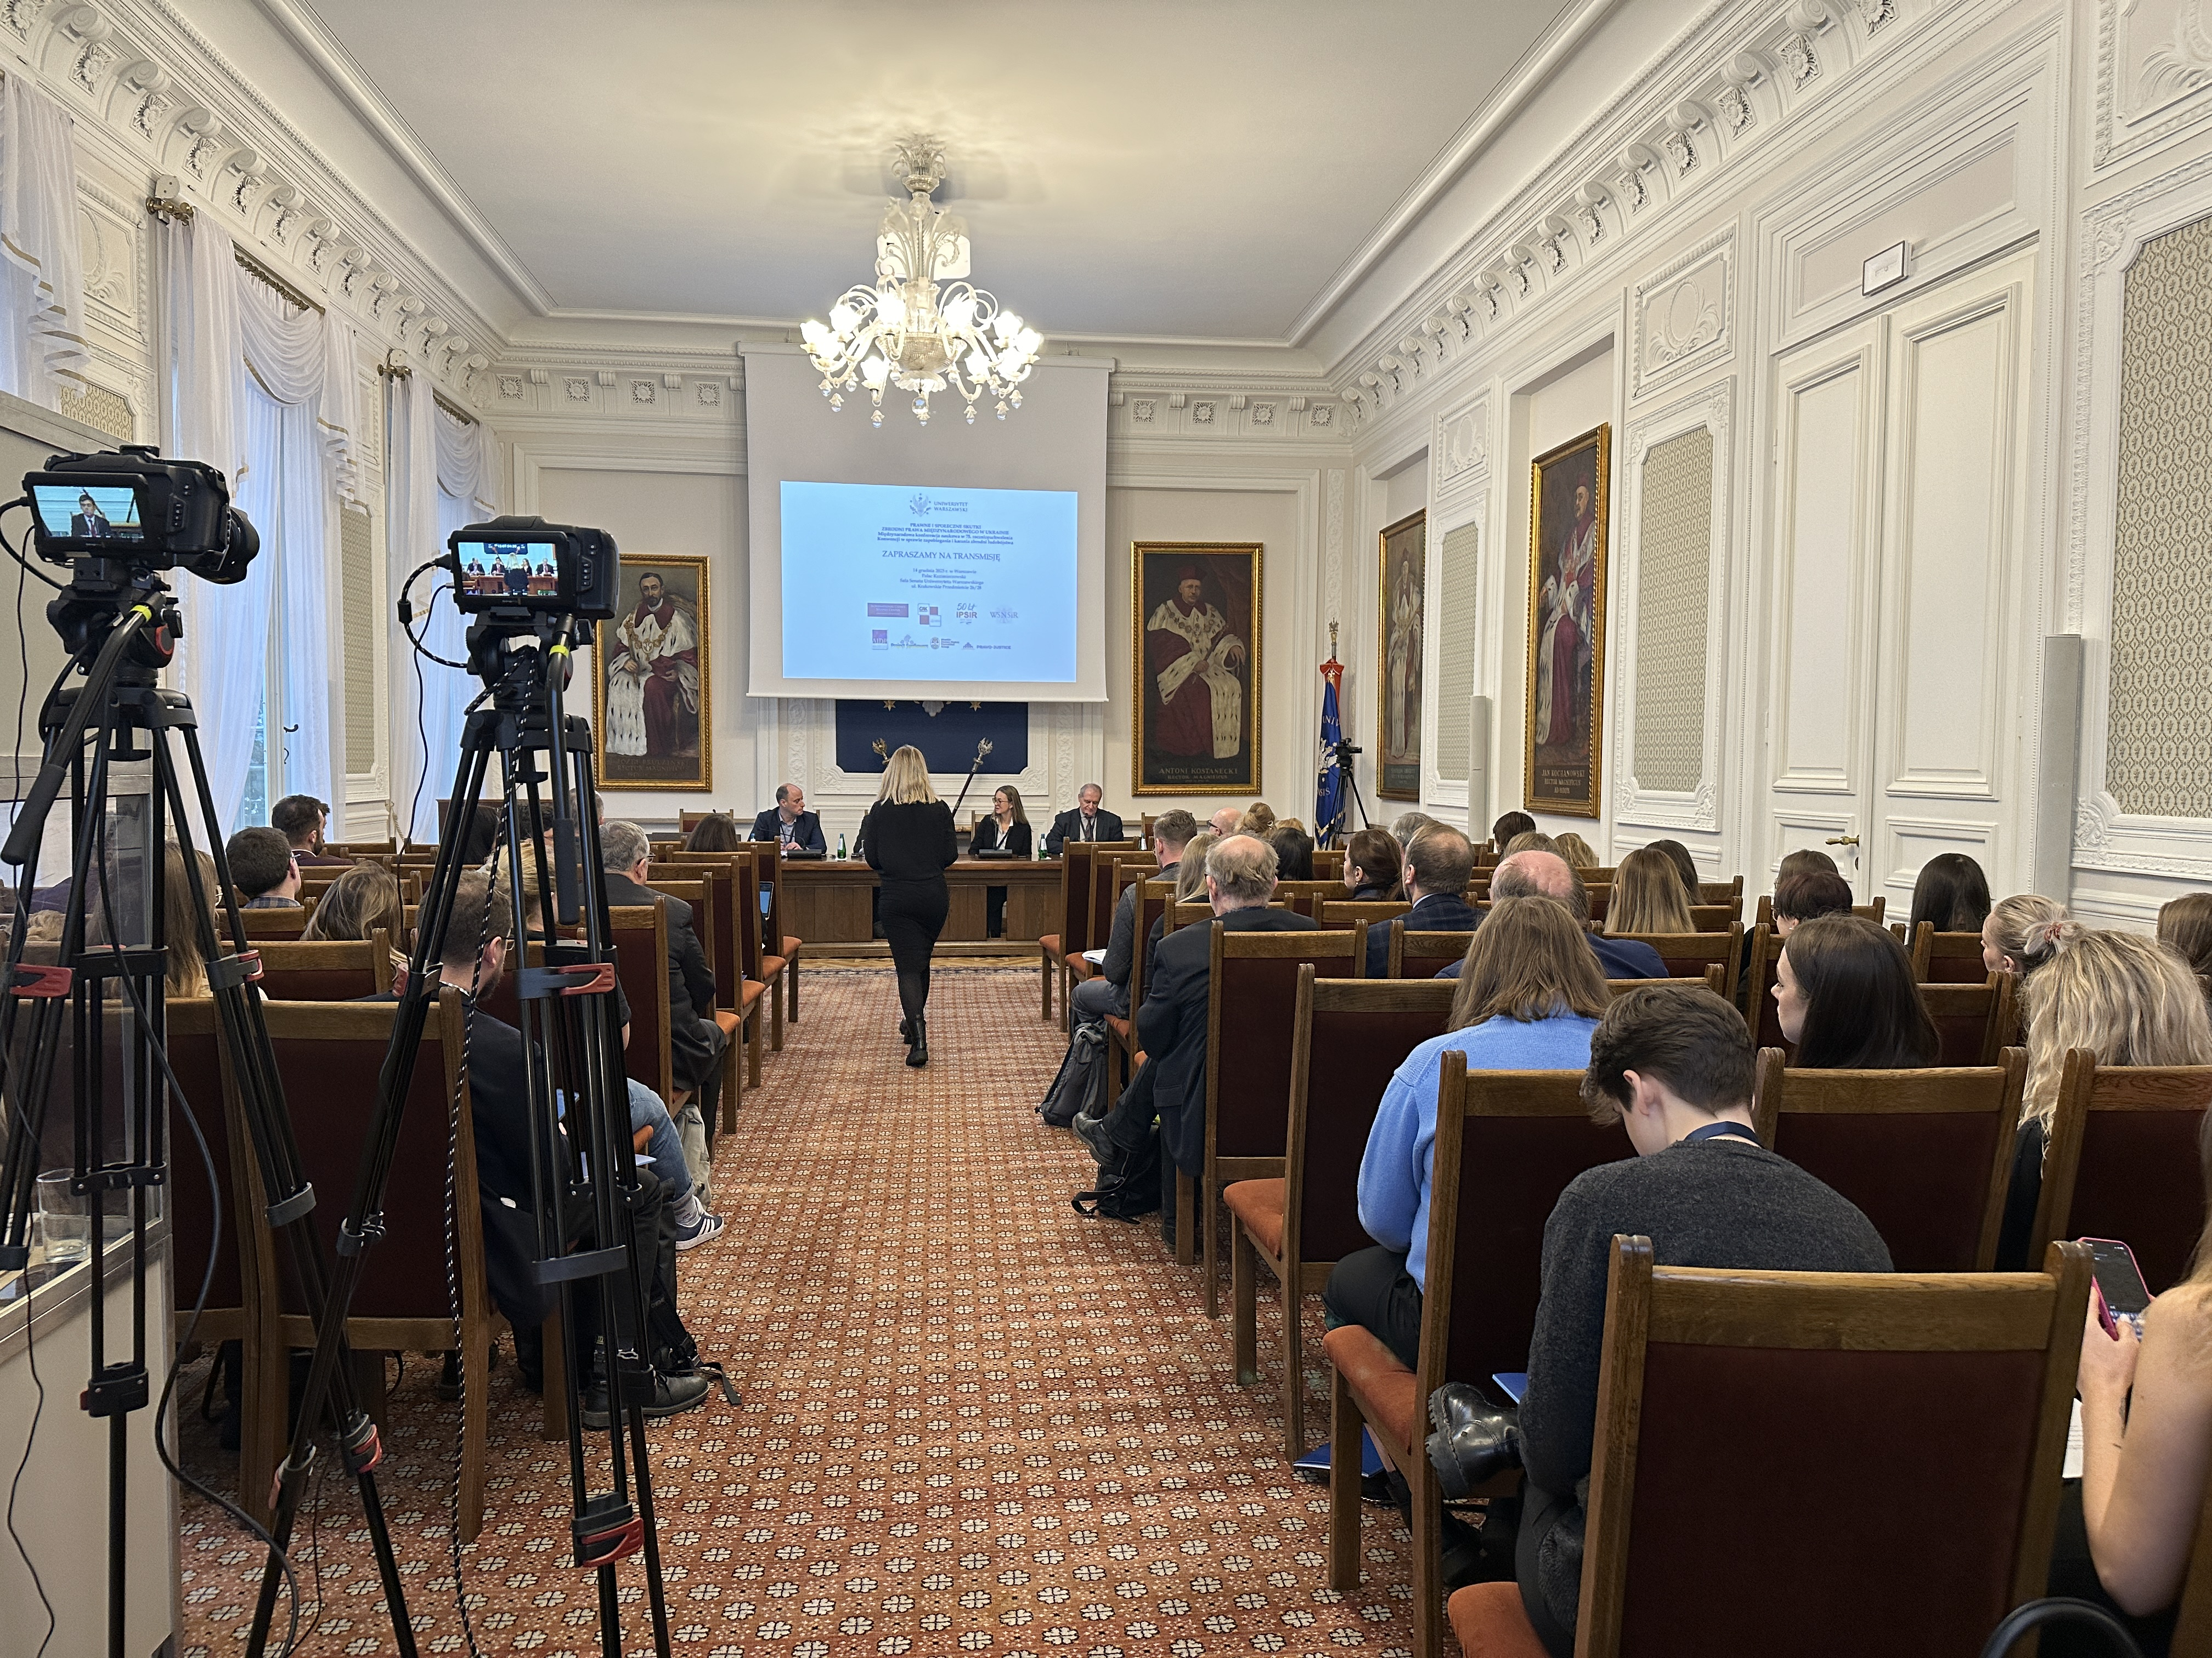
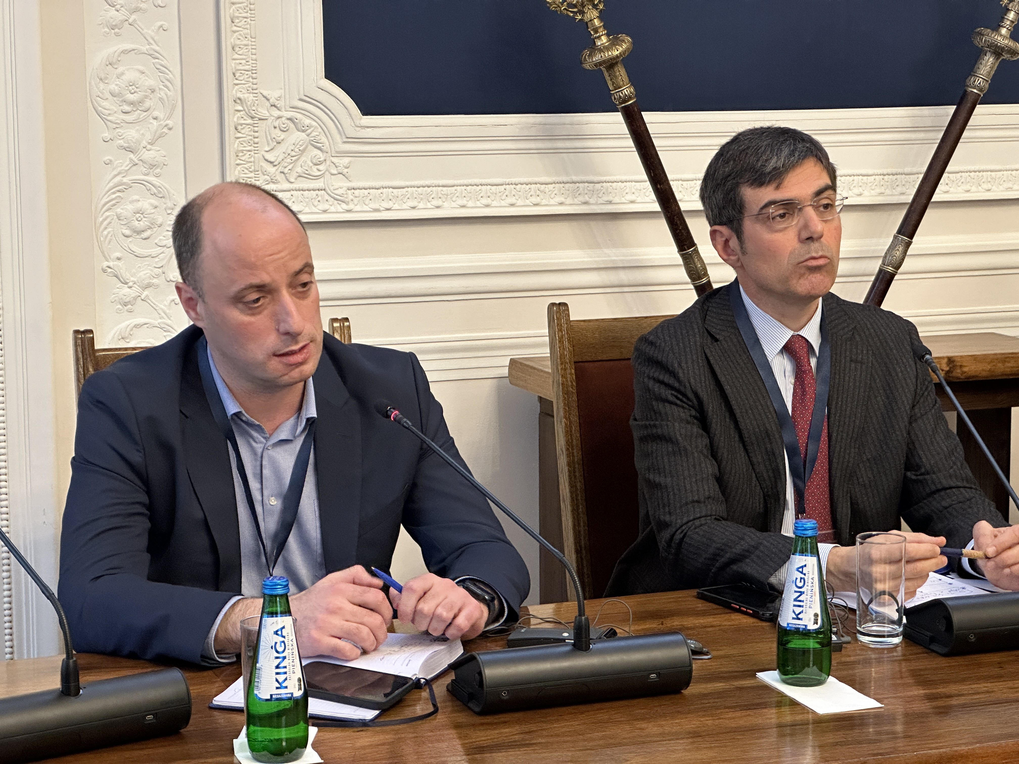
On December 14, 2023, an International Scientific Conference commemorating the 75th anniversary of the adoption of the Convention on the Prevention and Punishment of the Crime of Genocide, titled “Legal and Social Consequences of International Crimes in Ukraine,” was held in the Senate Hall of the Kazimierzowski Palace at the University of Warsaw.
The conference was organized by the International Crimes Studies Center, the Center for Criminological Analysis, the Department of Criminology and Criminal Policy, and the Institute of Social Prevention and Resocialization of the Faculty of Applied Social Sciences and Resocialization at the University of Warsaw. Partners of the event included:
• The Polish Section of the International Association of Penal Law (AIDP)
• The Sunflowers Foundation
• Kharkiv Human Rights Protection Group
• The European Union’s Pravo-Justice Project
Speakers and their presentations:
• Prof. David Donat Cattin, Professor at the Center for Global Affairs, New York University, and Board Member of the Global Institute for the Prevention of Aggression: The ICC investigations and prosecutions on international crimes perpetrated in the framework of the war of aggression in and against Ukraine, and the urgent need to reform its limited jurisdiction on the crime of aggression.
• Dr. Yuriy Bielousov, Director of the War Crimes Department, Prosecutor General’s Office of Ukraine: Peculiarities of the national system of Ukraine for prosecution of international crimes.
• Yevhen Zakharov, President of the Kharkiv Human Rights Protection Group: Approach of the Kharkiv Human Rights Protection Group to documenting and analysing international crimes and assisting victims.
• Dr. Matthew Gillett, Professor at the University of Essex, Vice-Chair of the UN Working Group on Arbitrary Detention: Attacks Against the Existence of a State as an Indicia of Genocidal Intent.
• Dr. Deborah Ruiz Verduzco, Director of the Trust Fund for Victims, International Criminal Court in The Hague: How the future of Reparations may look like for Ukraine.
• Dr. hab. Karolina Wierczyńska, Professor at the Institute of Legal Studies, Polish Academy of Sciences: From Lemkin’s Idea to the Genocide Convention.
• Dr. hab. Hanna Kuczyńska, Professor at the Institute of Legal Studies, Polish Academy of Sciences: How Lemkin’s Ideas Became Reality: The Practice and Challenges of Prosecuting Genocide.
• Dr. Barbara Błońska and Dr. Andriy Kosylo, University of Warsaw, International Crimes Studies Center: The Forced Transfer of Ukrainian Children to Russian Families: The Problem of Criminal Law Qualification.
• Prof. Katarzyna Celińska, John Jay College of Criminal Justice, The City University of New York, and Dr. Katarzyna Witkowska-Rozpara, University of Warsaw, Center for Criminological Analysis: The Response of Non-Governmental Organizations to the Crisis Related to the Influx of Ukrainian Refugees in Poland – Preliminary Research Findings.
• Dr. Maria Baran, SWPS University of Social Sciences and Humanities, Warsaw: Culturally Sensitive Recommendations for Entities Supporting Ukrainians in Poland – Results of Qualitative Research.
• Dr. hab. Mikołaj Pawlak, Professor at the University of Warsaw, and Agnieszka Kozakoszczak, Institute of Social Prevention and Resocialization, University of Warsaw: Intercultural Assistance in the Formal Education System in Poland.
• Dr. Liudmyla Dubchak, Associate at the Center for Criminological Analysis, University of Warsaw: Children from Ukrainian Orphanages During the War: Challenges for Poland and Other European Countries.
The conference was accessible both in person and online via the Zoom platform. Additionally, a live broadcast was available on YouTube. The recording of the conference can be viewed in two language versions (Polish and English) on the YouTube channel of the International Crimes Studies Center, University of Warsaw:
Polish version – https://youtu.be/1bGi1XHbO7A?si=ARHz2N8uFgNFnAcf
English version - https://www.youtube.com/watch?v=eZWZvGd-u2A

Slide 8
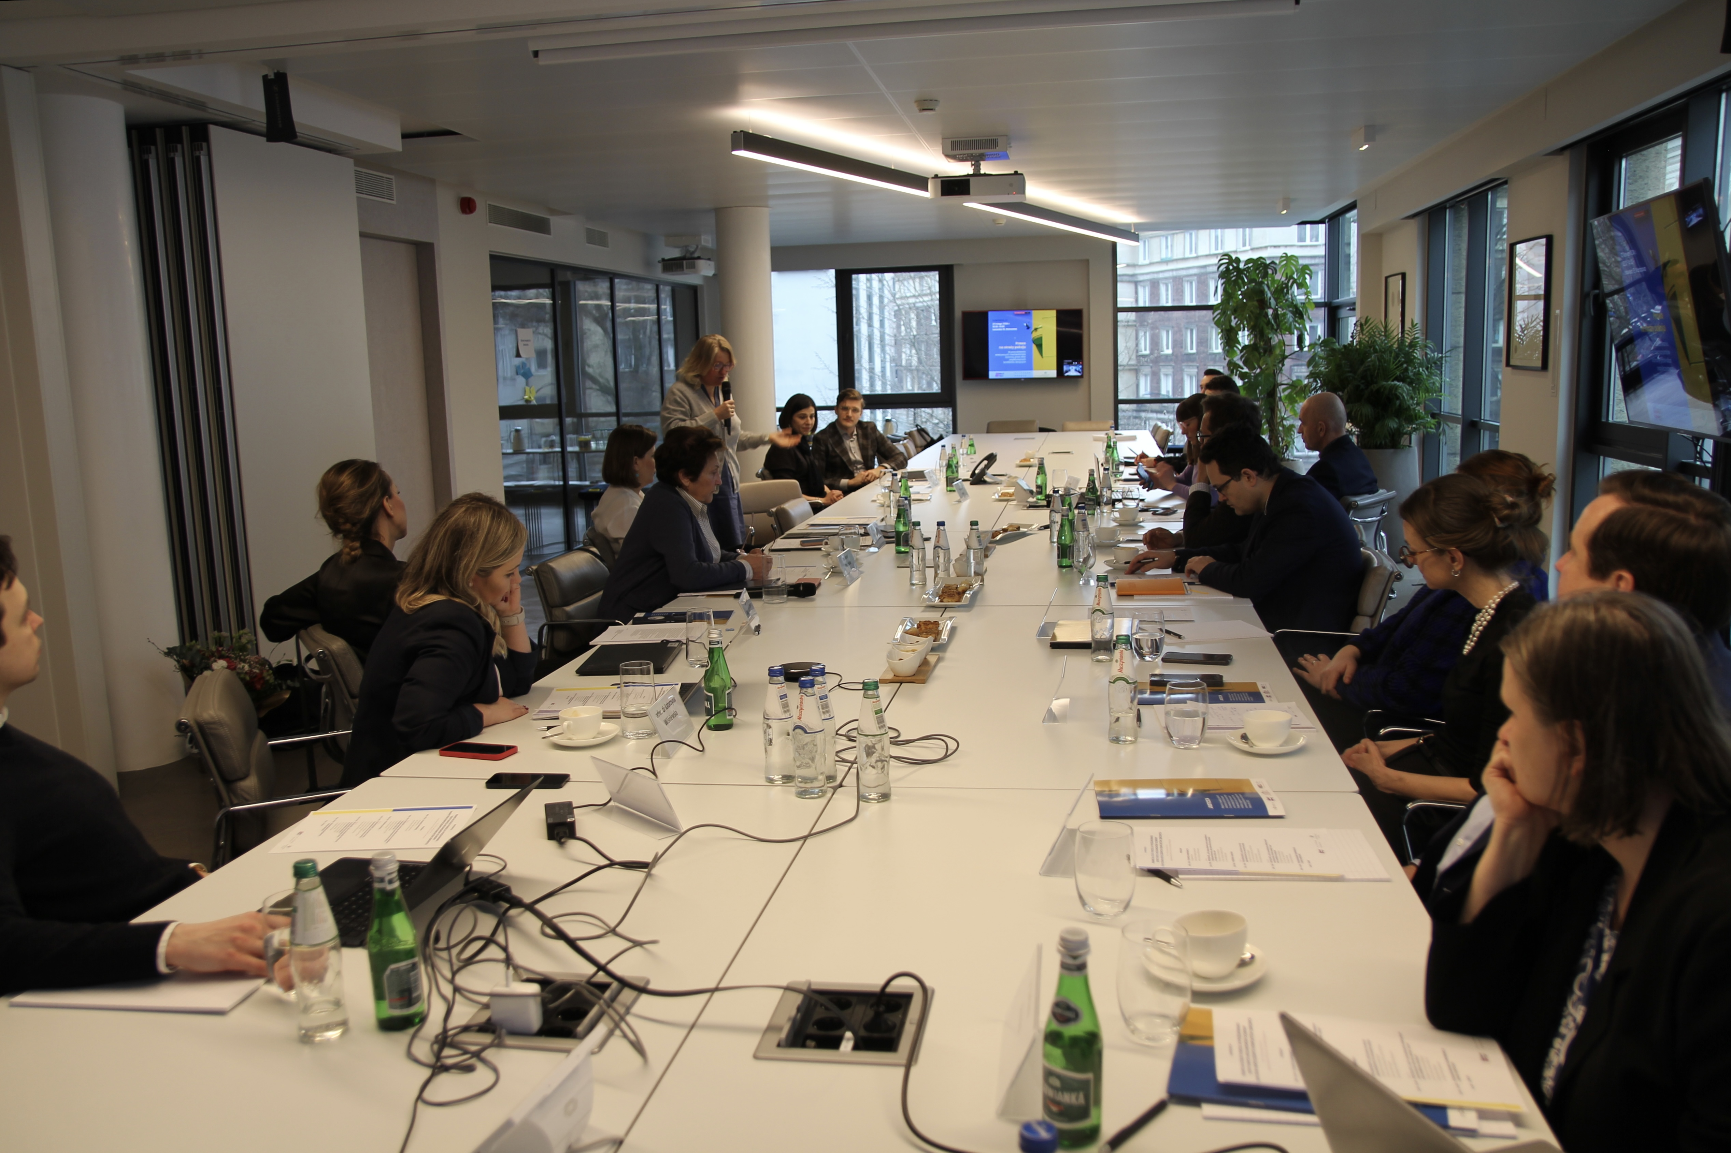
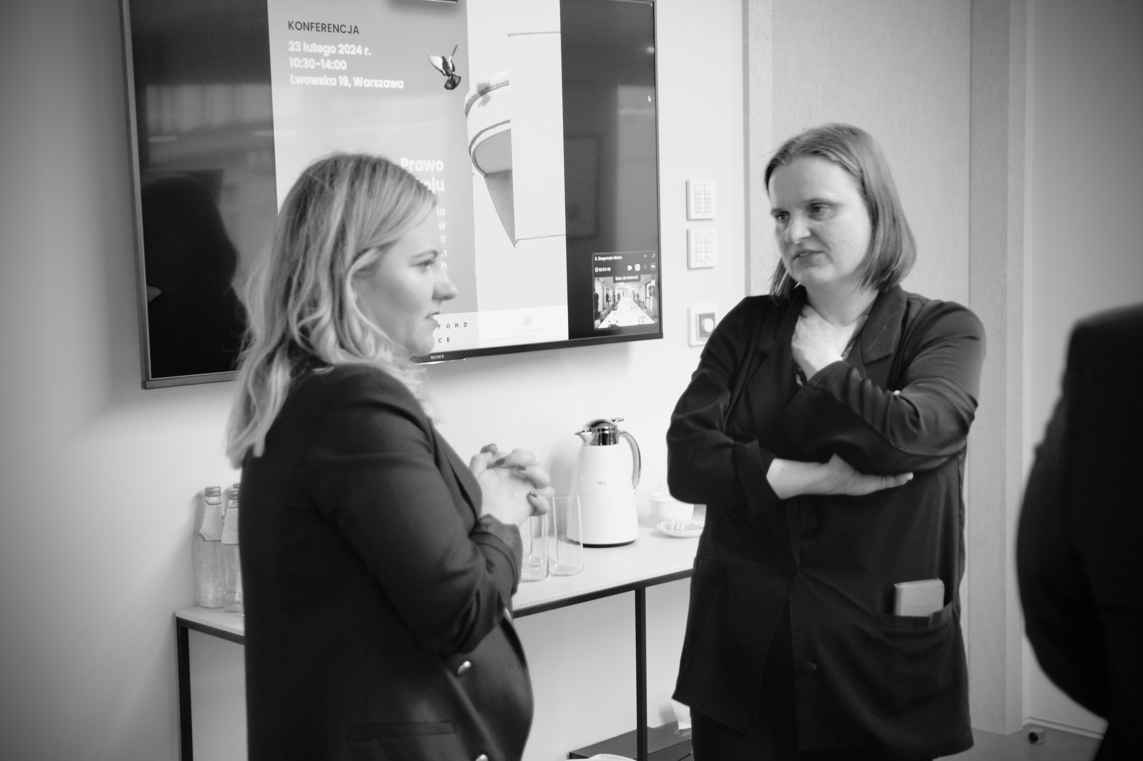
February 23, 2024
On February 23, 2024, the “Law as a Guardian of Peace: In Search of Effective Mechanisms to Protect the Rights of Victims of Modern Armed Conflicts” conference was held at the Clifford Chance offices in Warsaw.
The conference was organized by the #WolneSądy Initiative under the patronage of the National Bar Council.
The event was structured into three panels:
• Panel I – The Past: What European and international law lacked to effectively defend peace in Europe in 2022.
• Panel II – The Present: Law as the guardian of accountability for breaches of peace.
• Panel III – The Future: In search of effective mechanisms to protect peace and the rights of conflict victims.
The conference featured participants from non-governmental organizations, academia, and the legal profession, including: Advocate Sylwia Gregorczyk-Abram, Dr. Katarzyna Wiśniewska, Myroslava Keryk, Dr. hab. Patrycja Grzebyk, Prof. UW, Dr. Hanna Machińska, Dr. hab. Hanna Kuczyńska, Prof. INP PAN, Dr. Andriy Kosylo, Elena Wasylew, Nikita Grekowicz, Prof. Dr. hab. Paweł Wiliński, Dr. Barbara Błońska, Dr. Kaja Kowalczewska, Advocate Małgorzata Piekarska, Advocate Marek Karczmarzyk, Advocate Małgorzata Mączka-Pacholak.
The International Crimes Studies Center was represented by Dr. Barbara Błońska, who participated as a speaker in the third panel, titled “The Future: In Search of Effective Mechanisms to Protect Peace and the Rights of Victims of Armed Conflicts.”
Photos by: Małgorzata Majewska

Slide 9
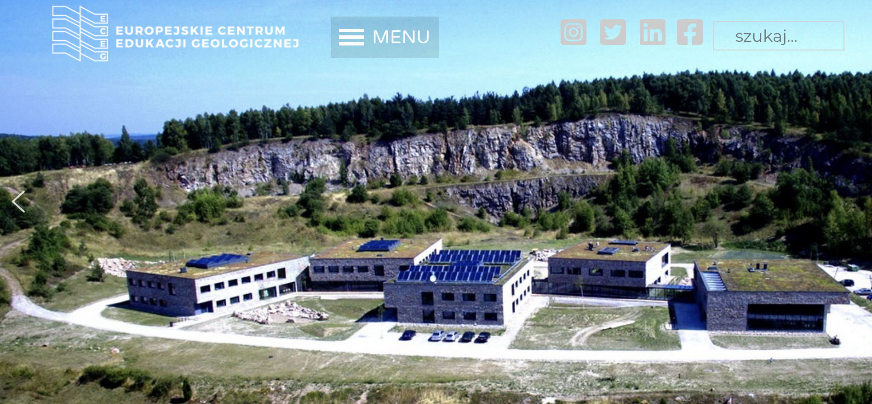
23.04.2024
On April 19-20, 2024, workshops for students were held at the European Centre for Geological Education of the University of Warsaw in Chęciny.
The workshops were organized by the International Crimes Studies Center and the Center for Criminological Analysis at the University of Warsaw. They focused on the issue of conspiracy theories, particularly as tools of warfare. The event was funded by the University of Warsaw’s Excellence in Teaching Fund.
These workshops mark the second event of this kind organized by the two centers. The first took place on September 27-29, 2023, and addressed hate-motivated violence.

Slide 10
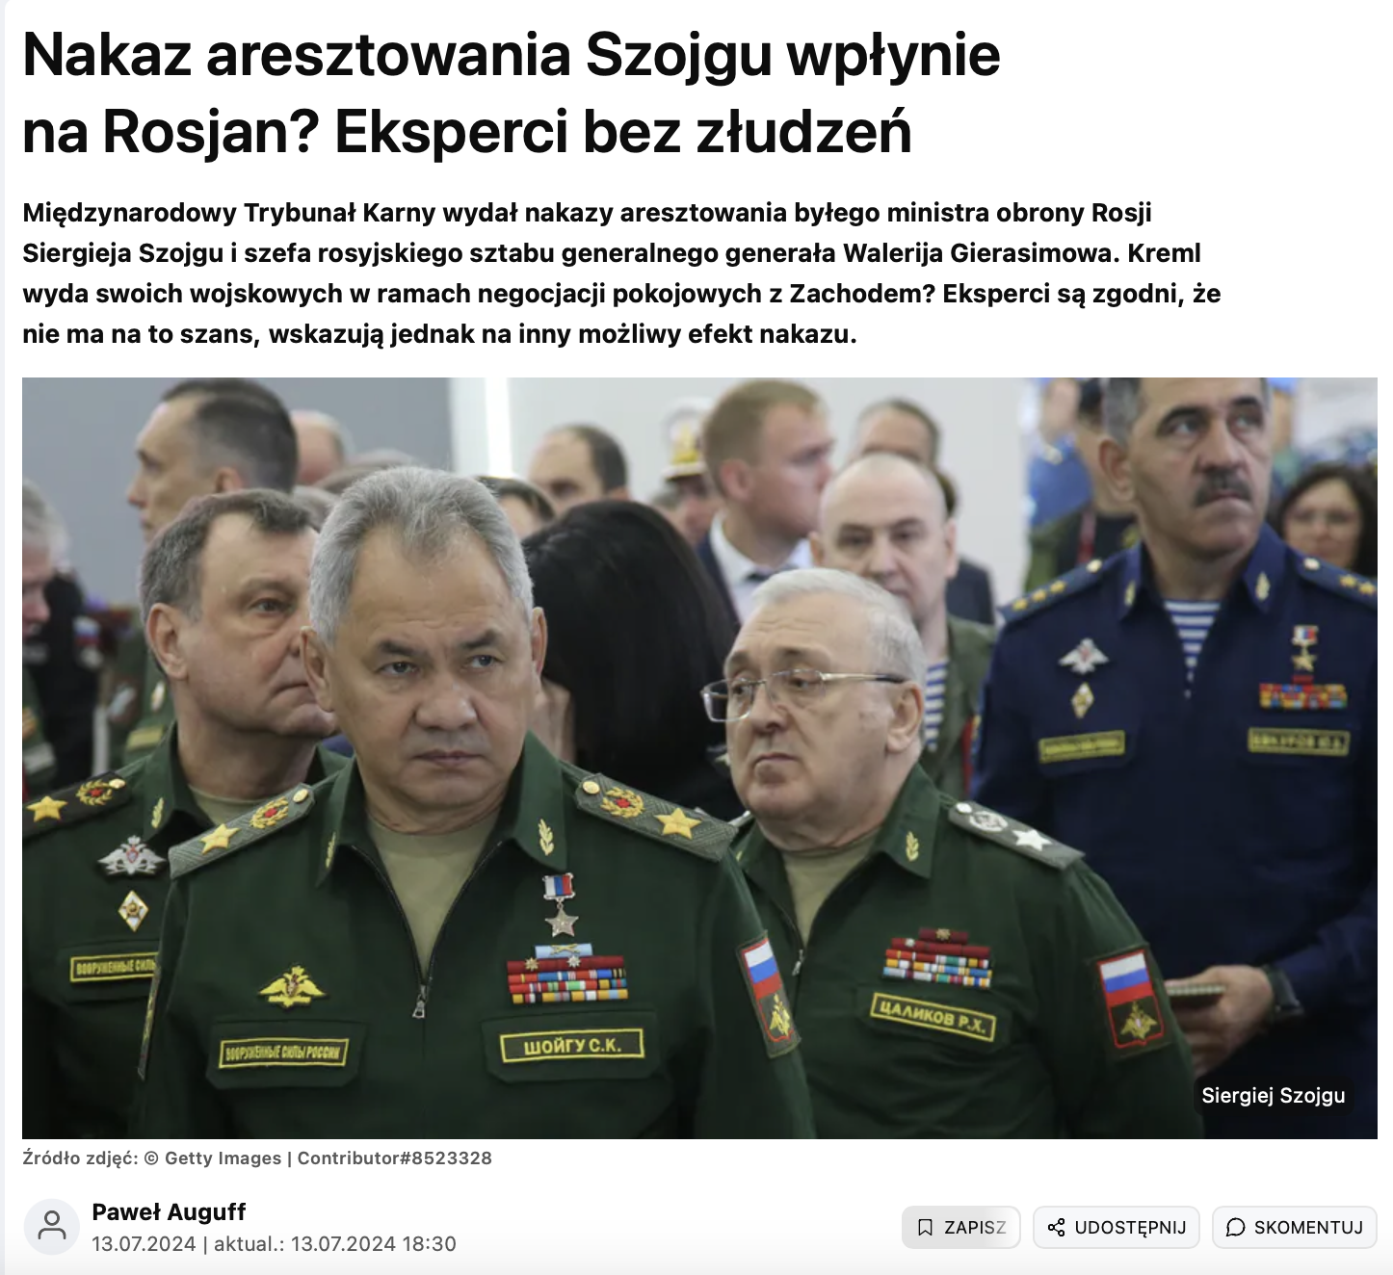
13.07.2024
Will the Arrest Warrant for Shoigu Affect Russians? Experts Have No Illusions.
An interview with Dr. Kosylo and other experts for Wirtualna Polska.
The interview particularly addressed the tools available to the International Criminal Court (ICC) for prosecuting individuals suspected of committing international crimes, including the mechanism of cooperation between the ICC and Interpol.
Link to the interview:
https://wiadomosci.wp.pl/s/pawel-auguff/nakaz-mtk-ws-szojgu-i-gierasimowa-eksperci-nie-maja-zludzen-7043495945998048a?

